Slide 1
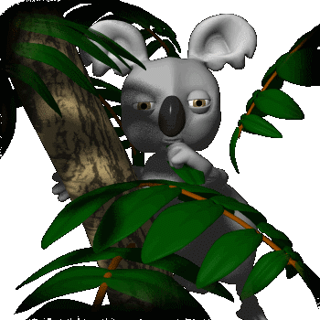
Food chain

Slide 2

Why do we eat food?
Food gives us energy

Slide 3


A hawk gets energy by feeding on small animals
Food chain
A frog gets energy by feeding on bugs and insects.
A plant uses energy from sun to make food.
A grasshopper gets energy by feeding on plants.

Slide 4
What is a Food Chain?
A food chain is the path by which energy passes from one living thing to another.

Slide 5
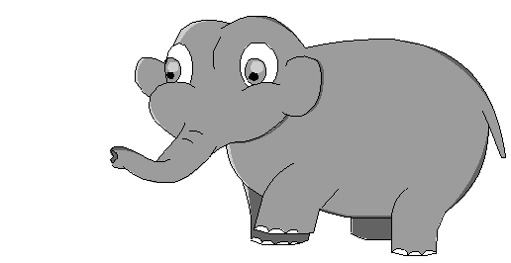
Words to Know
Producer – A producer is a living thing that makes its own food from sunlight, air and soil. Plants are producers.
Consumers – A consumer is a living thing that cannot make its own food. Consumers get their energy by eating food. All animals are consumers.

Slide 6
In a food chain plants are called as producers
In a food chain animals are called as consumers

Slide 7
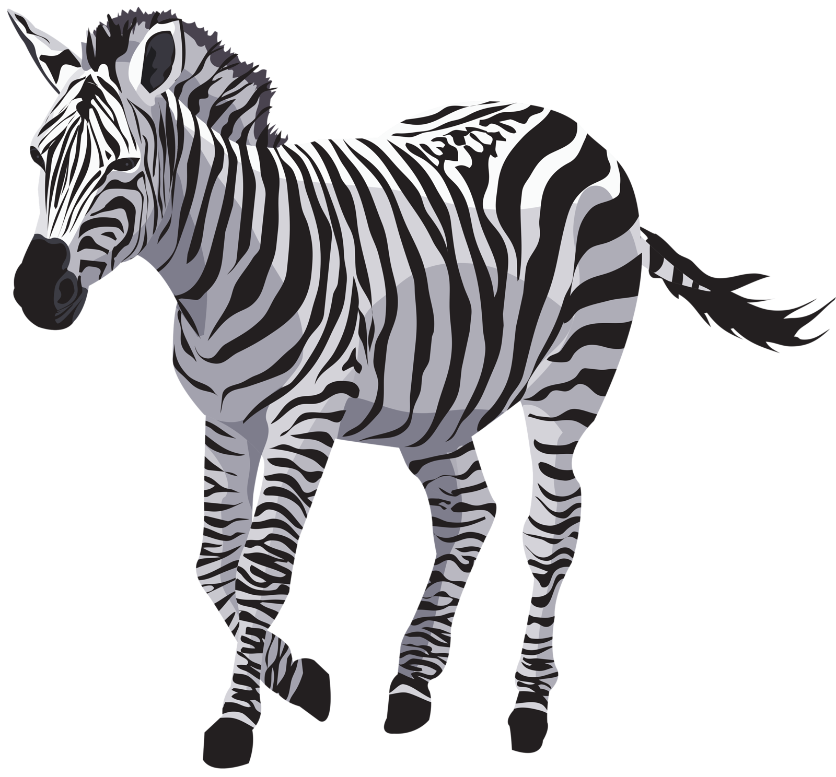
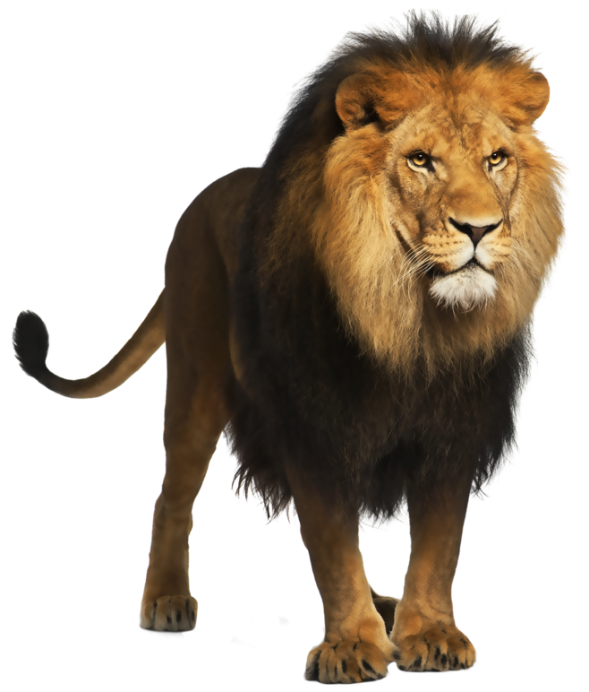
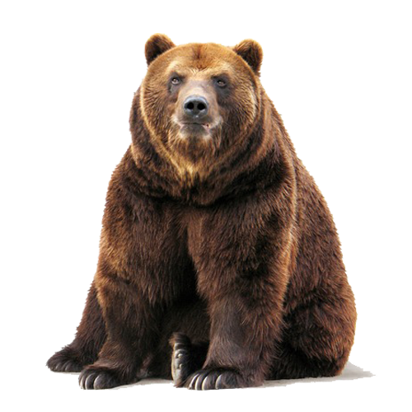
Types of Consumers
Herbivore – A herbivore is a consumer
that eats only plants.
Carnivore – A Carnivore is a consumer
that eats only animals.
Omnivore – An omnivore is a consumer
that eats both plants and animals.

Slide 8
Herbivore
Carnivore

Slide 9
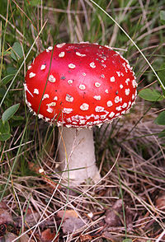
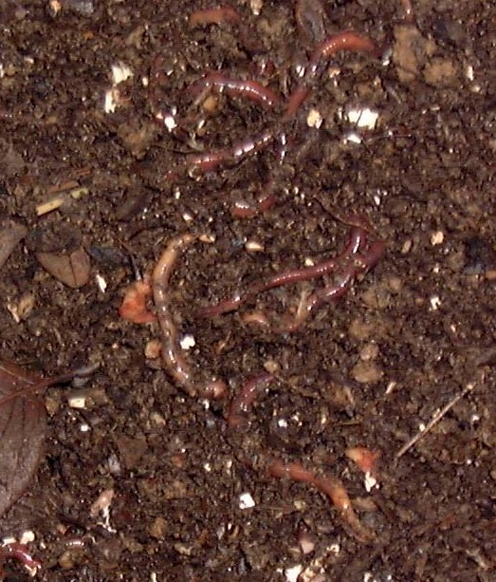
Decomposers
Break down dead plants and animals
Bacteria and fungi are two examples
Reduces dead organisms to simpler forms of matter
Returns them to the soil

Slide 10
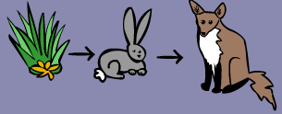
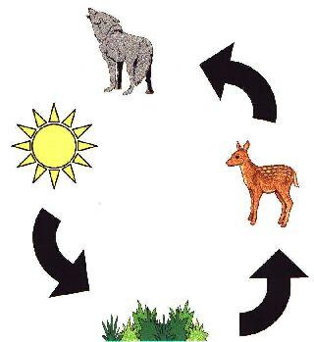
Food Chain
Shows how each living thing gets food
Always begins with the producer
Arrows show the flow of energy from one organism to another

Slide 11
Activity 1
Place the animals and plants into right order to show what eats what.

Slide 12
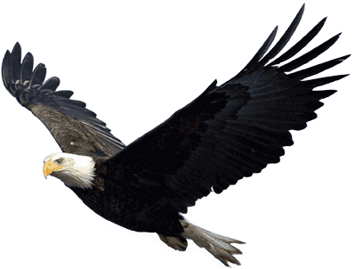
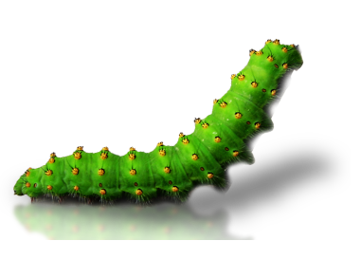
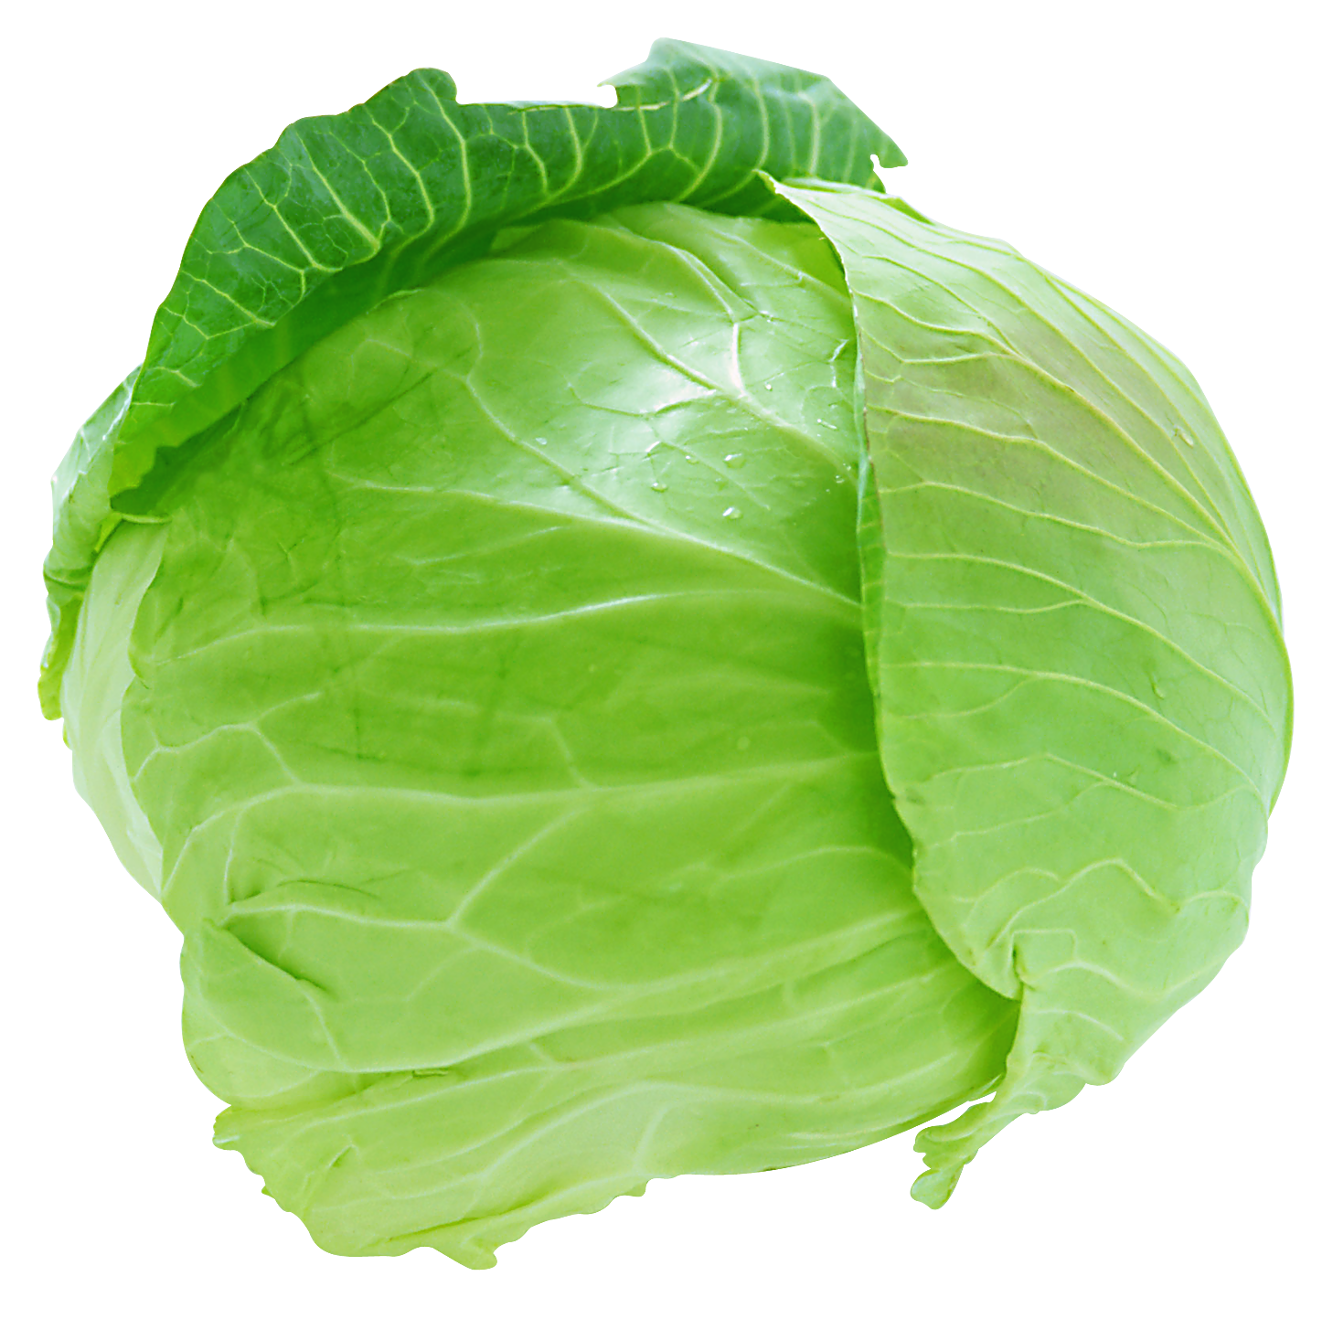
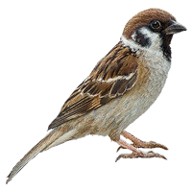

Slide 13
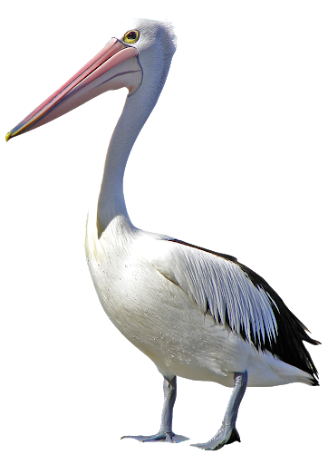
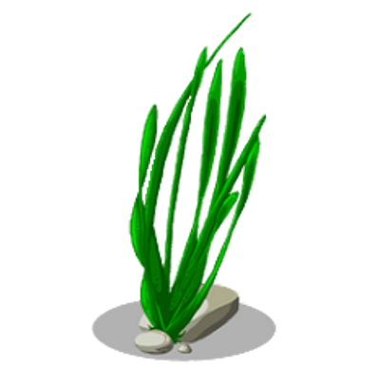
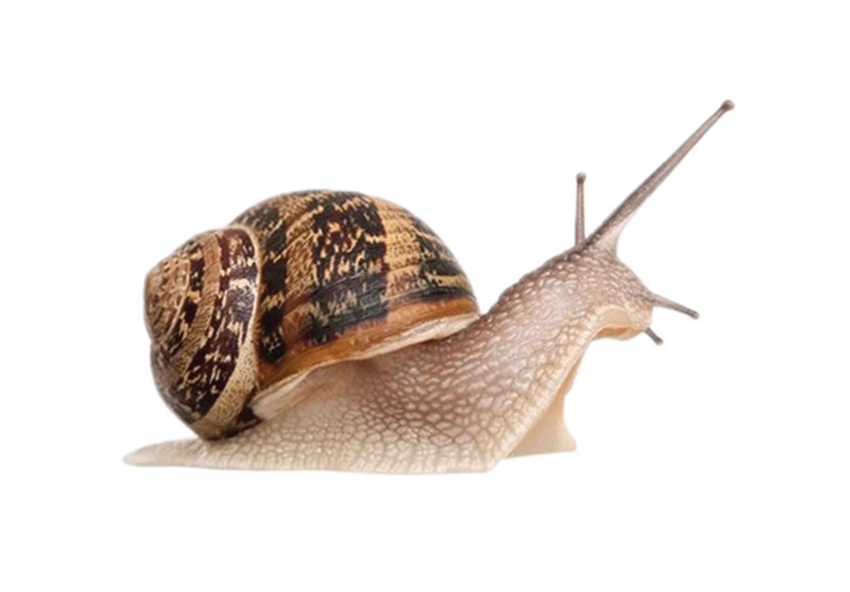
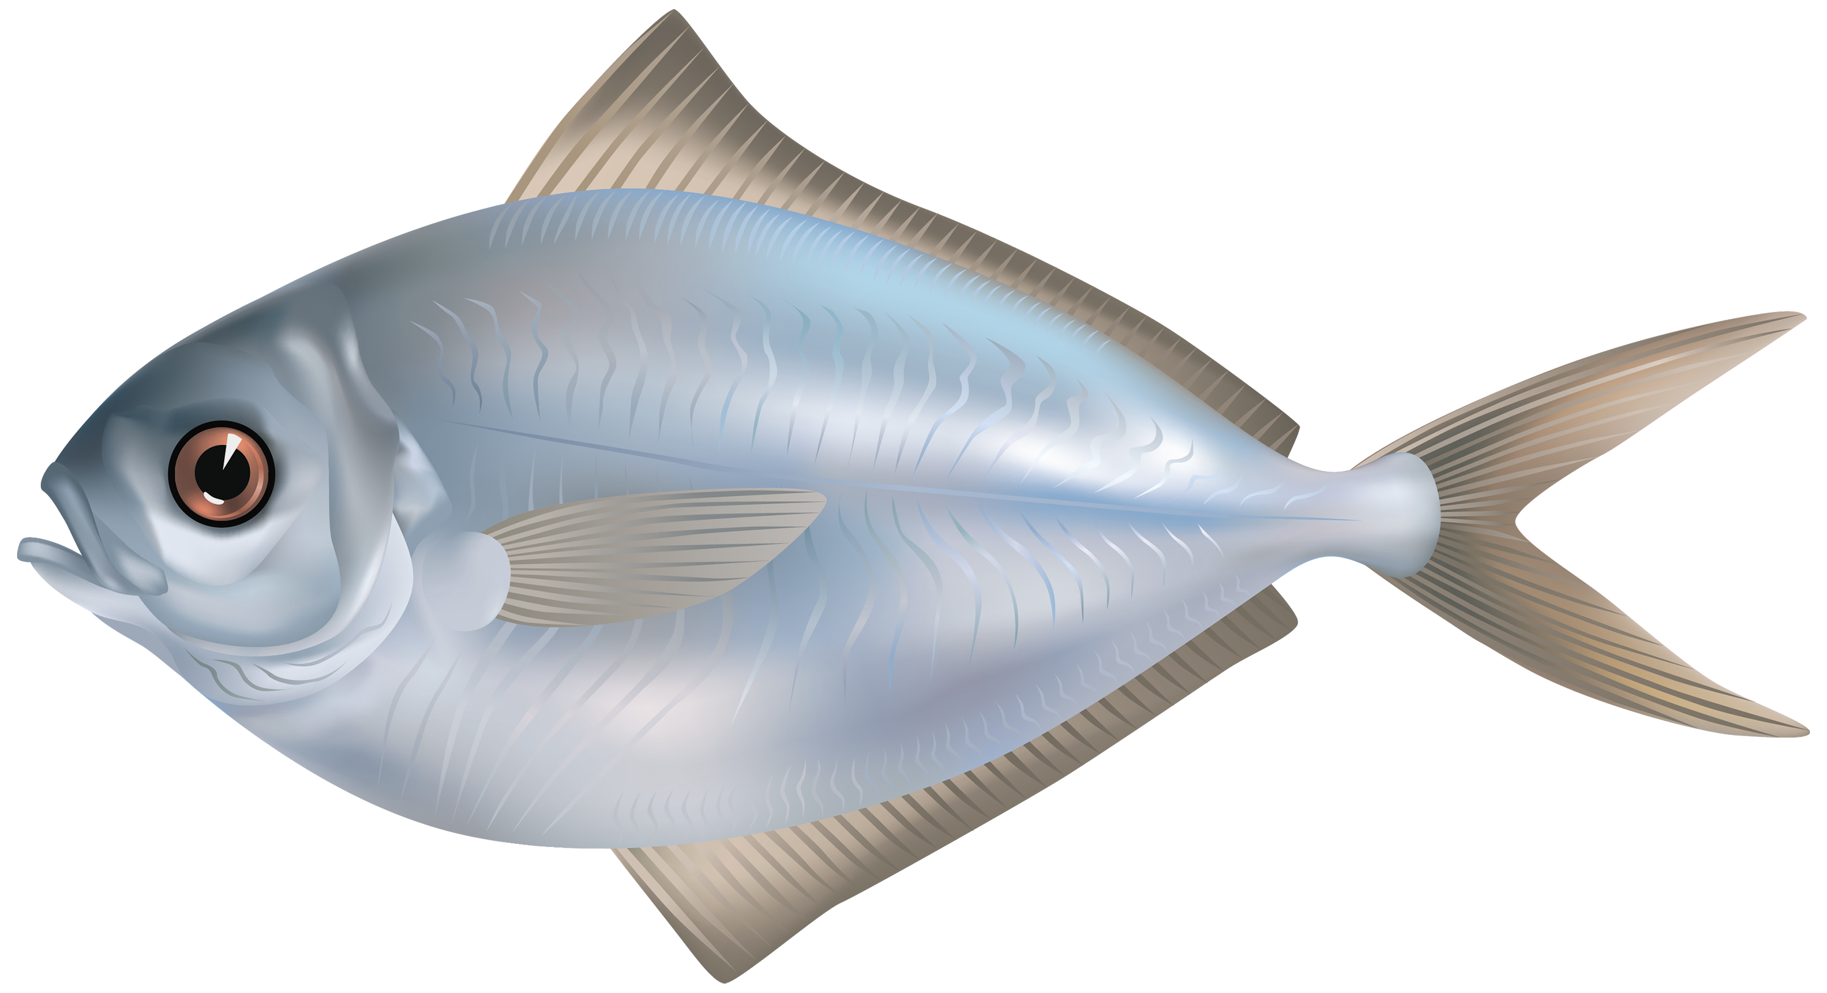

Slide 14
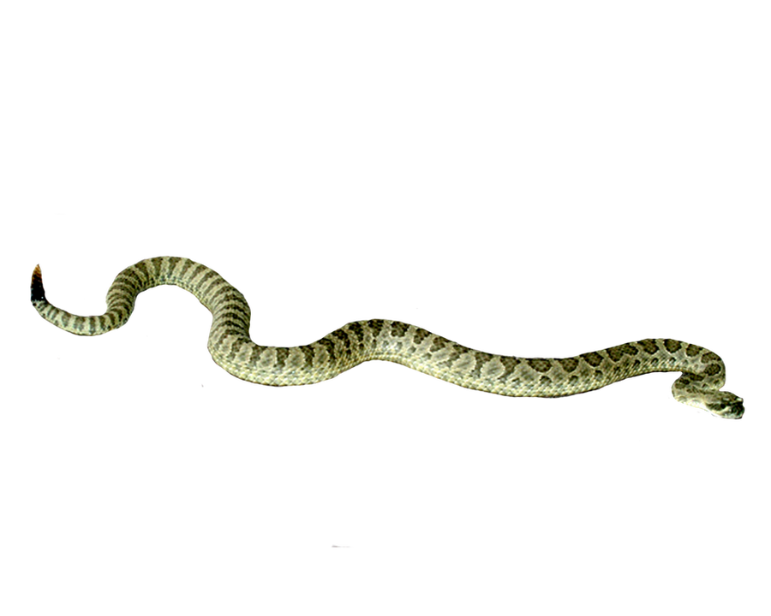
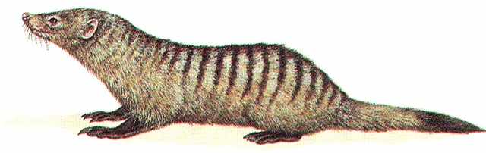
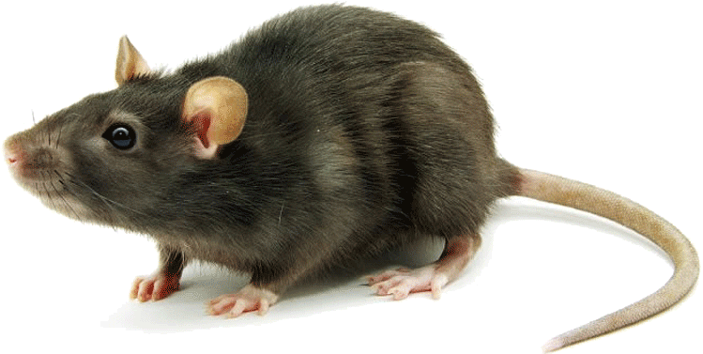
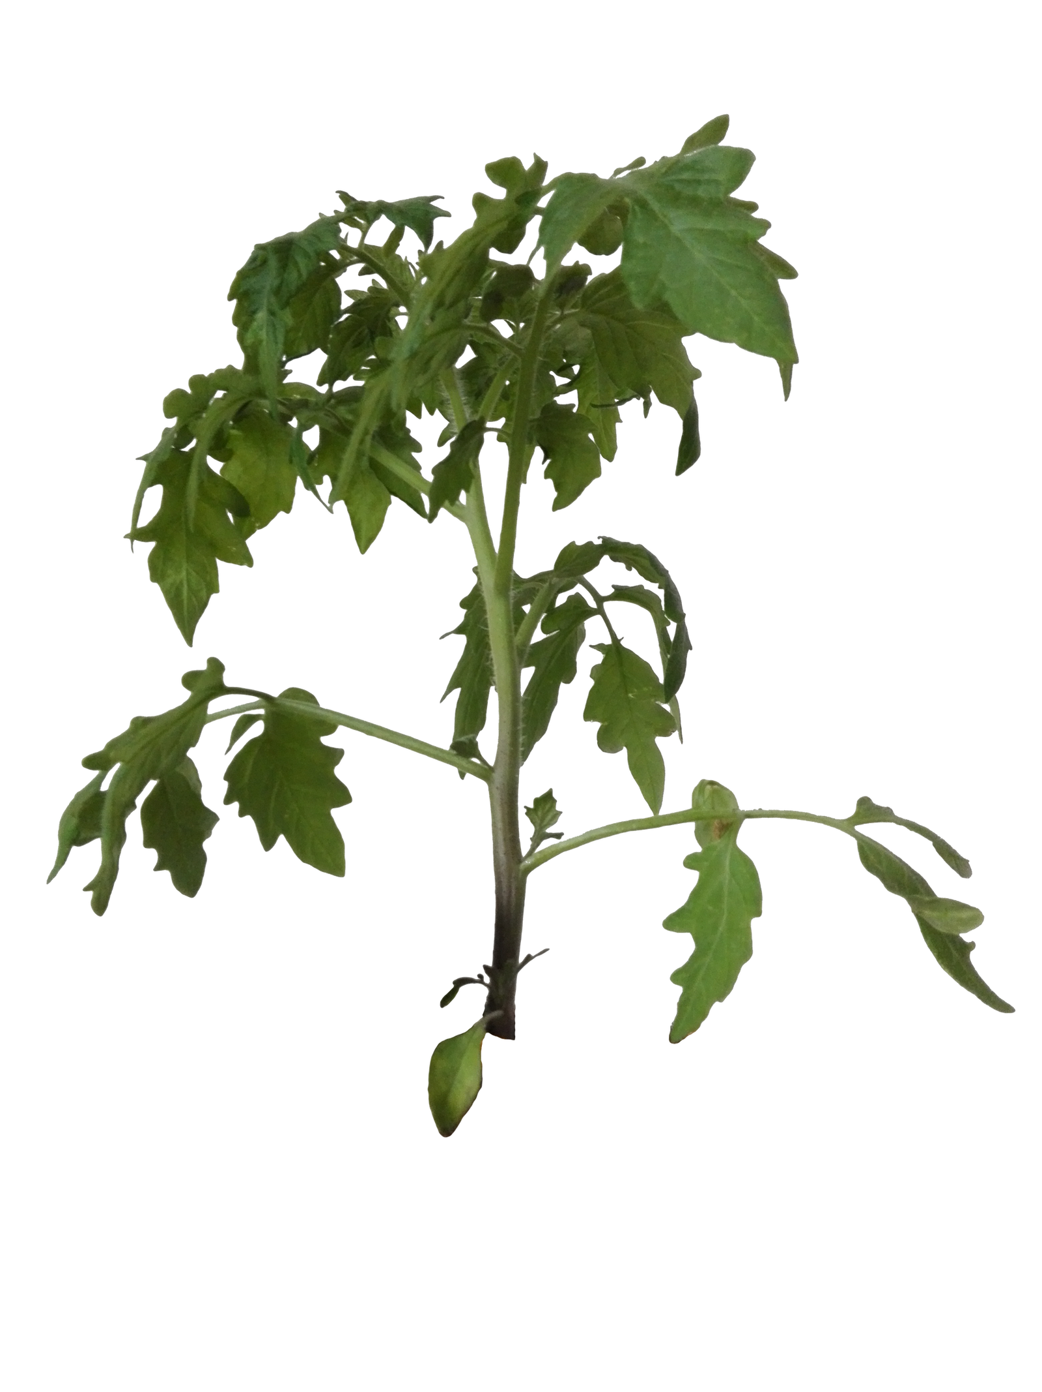

Slide 15
Activity 2
Tell whether each living thing below is a producer, consumer or decomposer

Slide 16
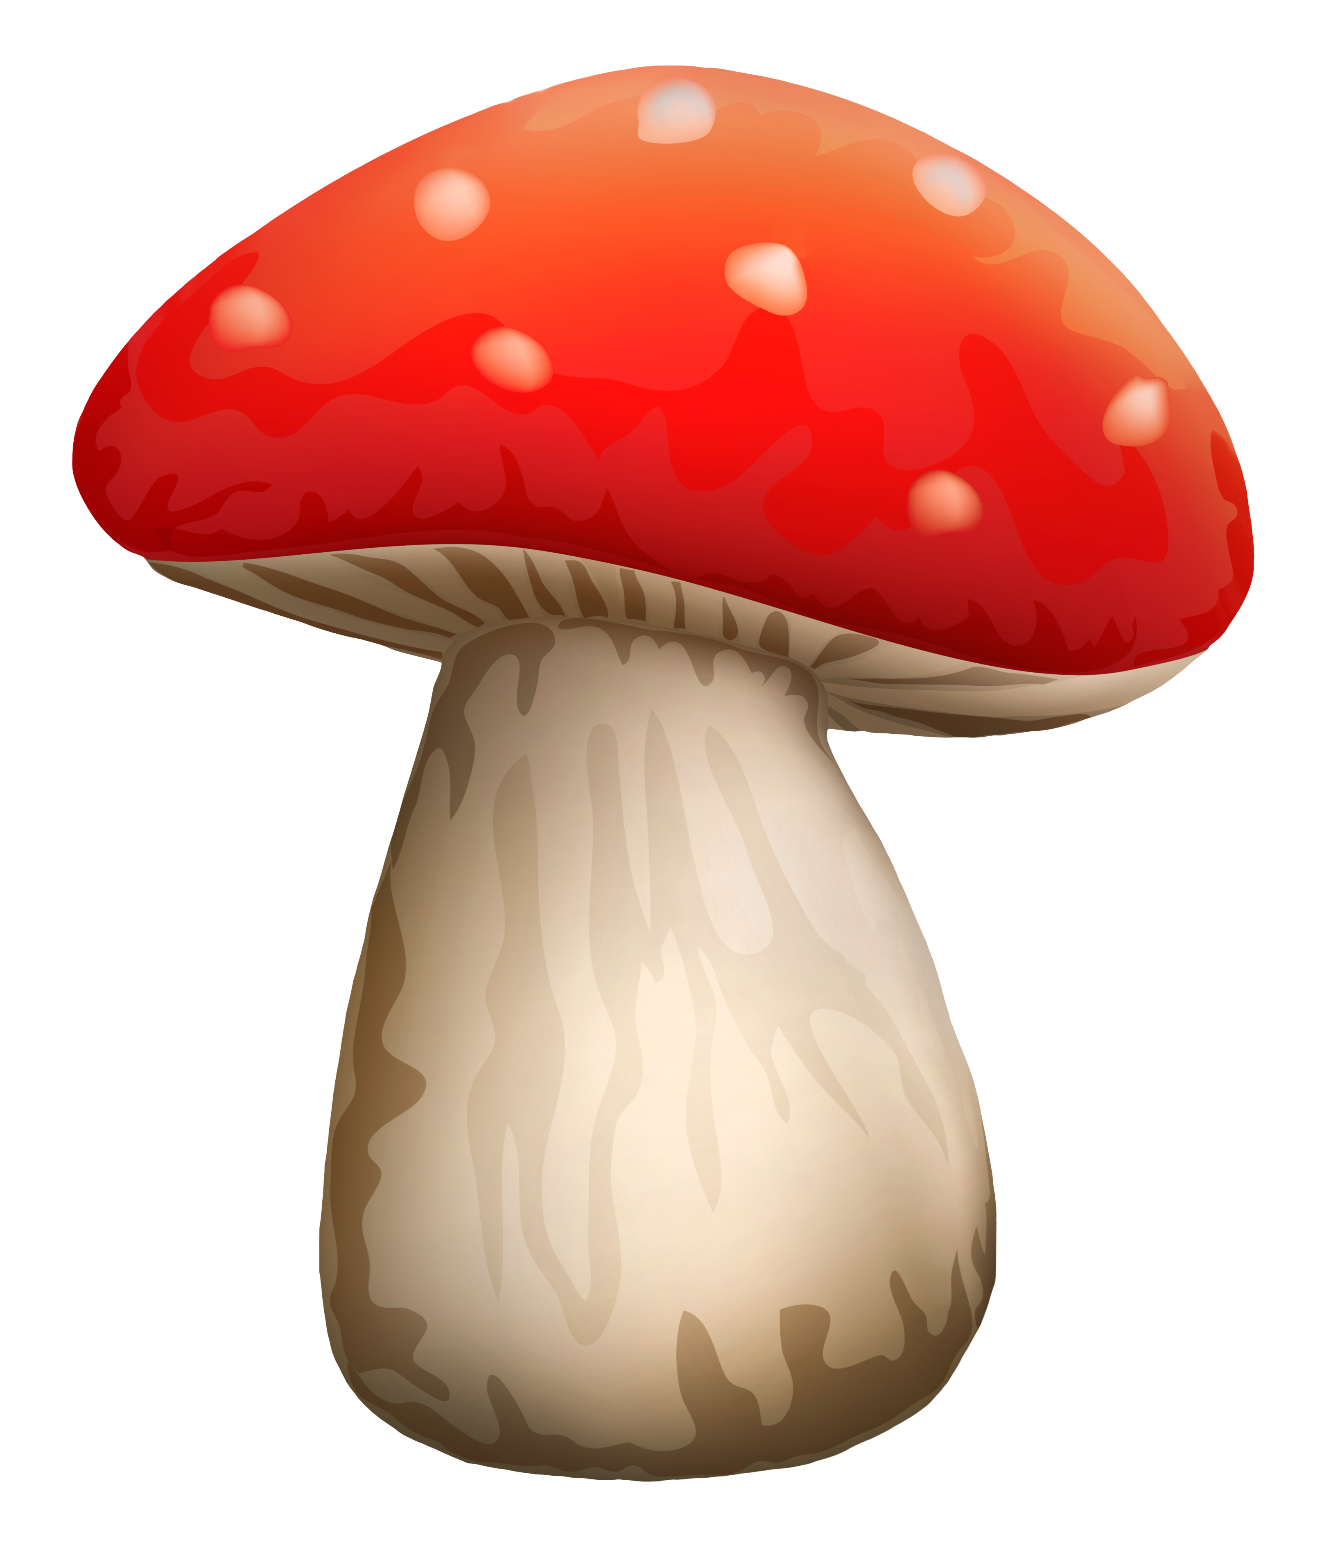

Mushroom
Producer
Consumer
Decomposer

Slide 17
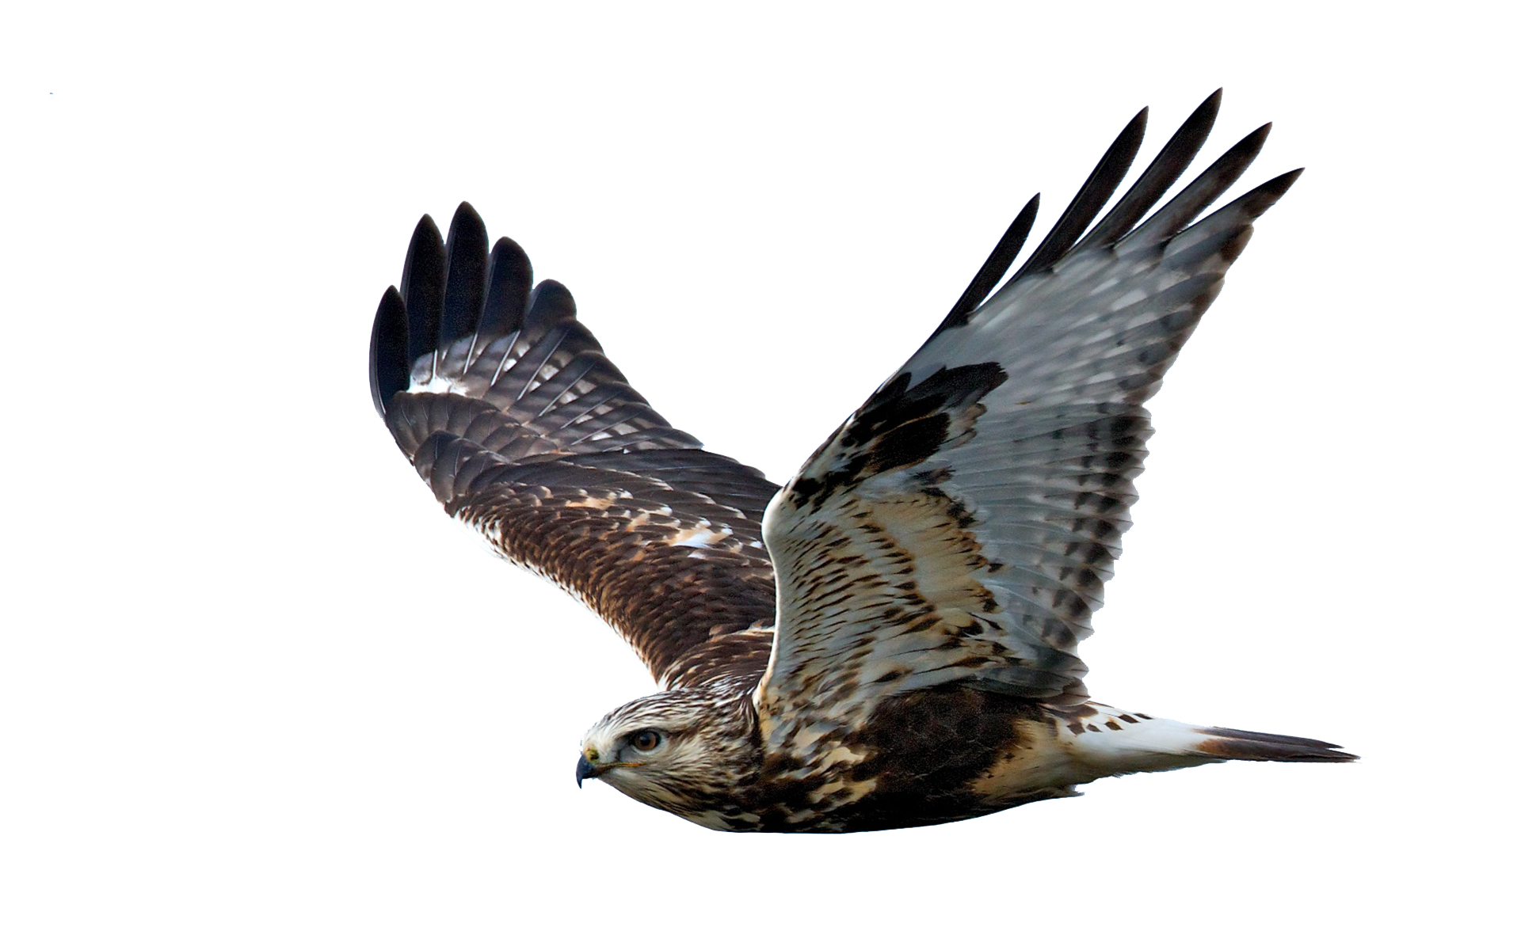
Hawk
Producer
Consumer
Decomposer

Slide 18
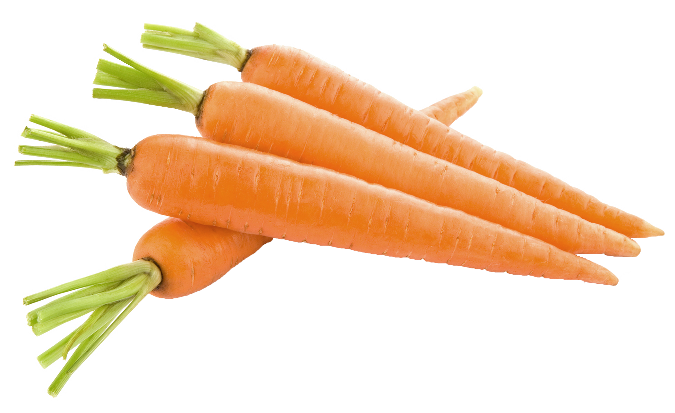
carrot
Producer
Consumer
Decomposer

Slide 19
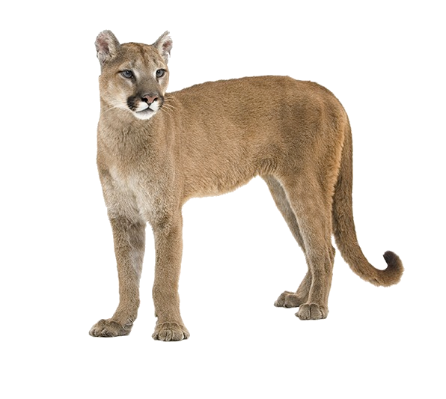
Cougar
Producer
Consumer
Decomposer

Slide 20
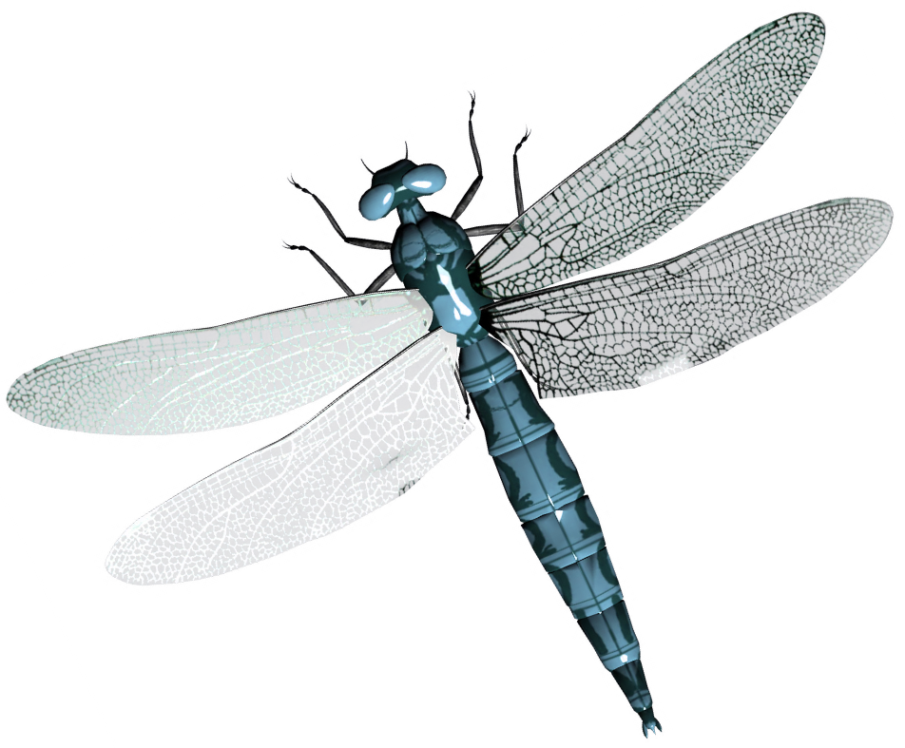
Dragonfly
Producer
Consumer
Decomposer

Slide 21
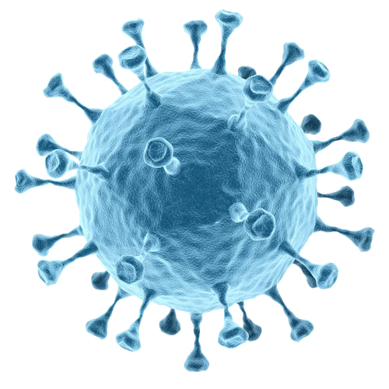
Bacteria
Producer
Consumer
Decomposer

Slide 22
Homework
EVS 2A workbook
Complete page 55 and 57

